Slide 1


Short Induction
for Cash Frontliners
Basics of Gender-Based Violence (GBV) Risk Mitigation &
Protection from Sexual Exploitation,
Sexual Abuse and Sexual Harassment (PSEA)

Slide 2
Your responsibilities regarding women and other people at greater risk of abuse and exploitation
During cash distributions, some population groups – such as women heads-of-household, widows, children and people with disabilities – may face a much greater risk of being abused, getting their cash stolen, or having difficulty reaching the distribution site. Even private companies working in the humanitarian response have the responsibility to:
Decrease those risks as much as possible
Always treat all beneficiaries in a respectful and dignified manner
Follow the rule of “zero tolerance for sexual exploitation, abuse and harassment” in all interactions between your organization’s or company’s staff and beneficiaries. This means no tolerance for any “actual or attempted abuse to obtain sexual favours in exchange for assistance” by yourself or anyone else who is working with you in any capacity.

Slide 3
What do GBV risk mitigation and PSEA mean concretely for you?
Inform all beneficiaries that “assistance is free” – requiring no payment or favor of any kind
Make sure a complaint and feedback mechanism is in place (e.g. protection desk, hotline, community focal points, etc.) is well known by beneficiaries, and that beneficiaries know they have the right to give feedback without fear of any penalty, including loss of assistance.
These messages and contact details for feedback-complaint channels can be on posters and also take place in face-to-face conversations for people who cannot read.

Slide 4
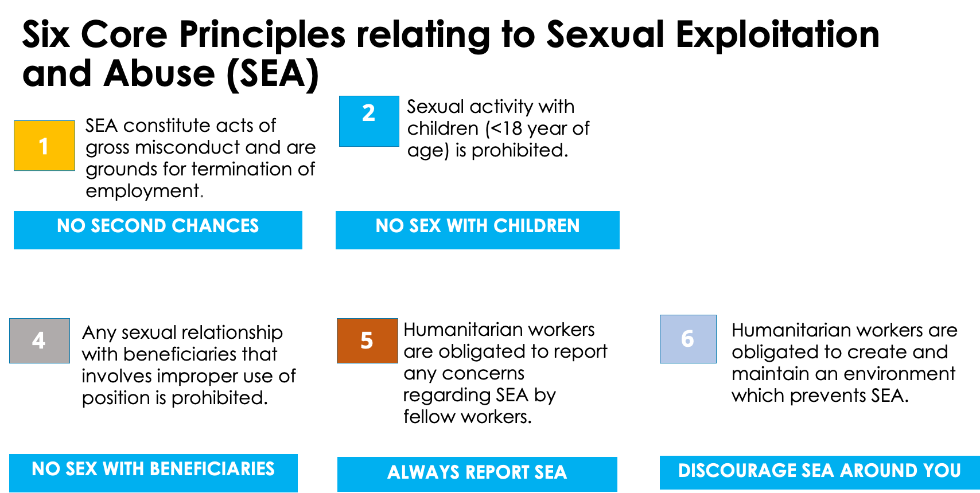
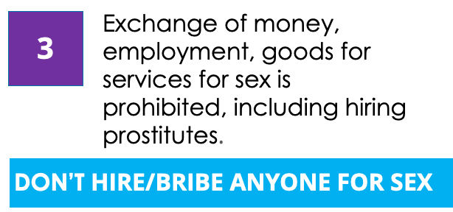
If you see something, say something: (INSERT CONTACT)

Slide 5
Following the rule of “zero tolerance for sexual exploitation, abuse and harassment (SEA)”: What does it concretely mean for you?
Everyone in your team should know what SEA is and know that reporting any case of SEA is mandatory.
Everyone involved should have signed a Code of Conduct, including drivers, volunteers, etc.
If possible, female beneficiaries should be able to interact with & receive assistance from female staff
You should wear a visible sign such as vest/cap – if security allows – so that beneficiaries are able to identify you.
Secure an appropriate location to distribute the money. This means having separate lines for men and women and having safety measures in place, such as limiting the number of people at a distribution in order to reduce chances for harassment, abuse and other risks.
These protocols and practices are a central part to any contract signed between financial service providers and humanitarian organizations. Not abiding by these principles will lead to a contract review and possible termination.

Slide 6
What if someone discloses a GBV incident to you?
First, never ask or look for survivors of violence if you are not a protection or GBV specialist.
If someone comes to you for support (for himself/herself or for someone else):
  Do NOT judge
  Do NOT try to solve the issue/find solution yourself
  Do NOT disclose the information to a third party
  DO listen with respect
  DO link to a specialised organization available in your area
Make sure you have the contact details of protection/GBV services available in your area so that you can provide this information if someone needs support.

