Slide 1
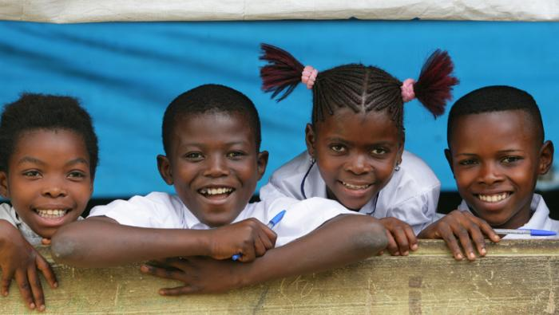
Child Protection Area of responsibility
GBV Briefing
Enhancing CP coordination and response in humanitarian settings
Notes:
Change picture for each session

Slide 2


Who is a child?
“Any Person Below the Age of 18”

Slide 3
What is child protection?
Child Protection is the Prevention of and Response to abuse, neglect, exploitation of and violence against children.

Slide 4
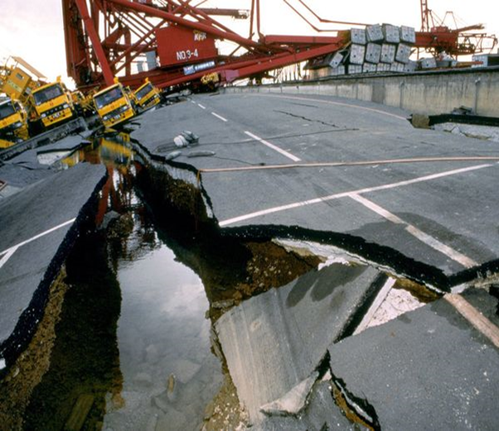
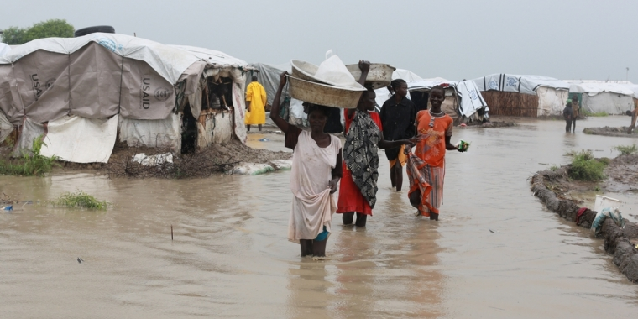
Natural Disaster

Slide 5
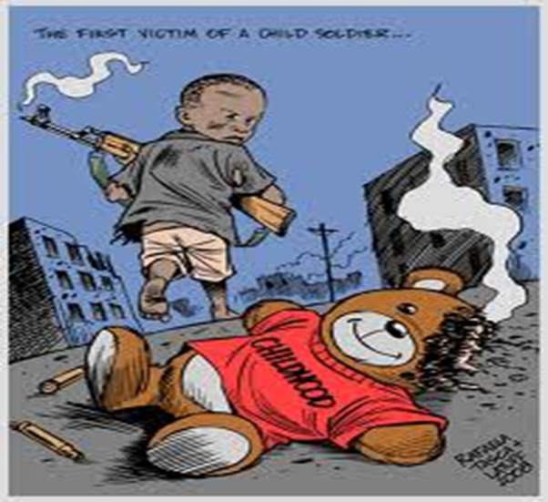
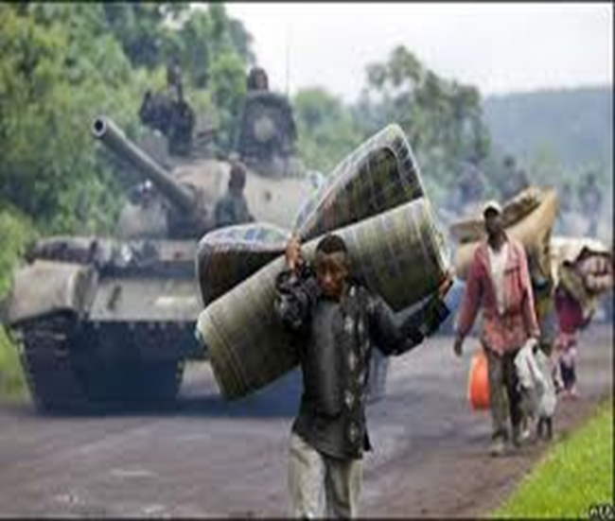
Armed Conflict

Slide 6
When an emergency strikes/ or a situation develops
It is news
Everyone is rushing for safety
Capture the story/ be the first to report
BUT
Because of their vulnerability – All children need special care and protection to ensure their safety and well-being
Therefore :
Media reporting on children and young people should never put them at risk- should be Ethical
Informed sensitive and professional reporting should be the key element in any media strategy
Notes:
Situation that threatens the lives and well-being of large numbers of a population and requires extraordinary action to ensure their survival, care and protection.
E.g. Natural Disaster or Armed Conflict

Slide 7
Principles for Ethical reporting on children
Respect the dignity and rights of every child in every circumstance.
In interviewing (and reporting on) children, pay special attention to each child's right to privacy and confidentiality, to have their opinions heard, to participate in decisions affecting them and to be protected from harm and retribution.
Protect the best interests of each child over any other consideration, including advocacy for children's issues and the promotion of child rights.
When trying to determine the best interests of a child, give due weight to the child's right to have their views taken into account in accordance with their age and maturity.
Consult those closest to the child's situation and best able to assess it about the political, social and cultural ramifications of any reportage.
Do not publish a story or an image that might put the child, their siblings or peers at risk, even when their identities are changed, obscured or not used.

Slide 8
Seven Guidelines for reporting on children
Do not further stigmatize any child; avoid categorizations or descriptions that expose a child to negative reprisals
Always provide an accurate context for the child's story or image.
Always change the name and obscure the visual identity of any child who is identified as:
- a victim of sexual abuse or exploitation
- a perpetrator of physical or sexual abuse
- HIV positive, or living with AIDS, unless the child, a parent or a guardian gives fully informed consent
- charged or convicted of a crime.
In certain circumstances of risk or potential risk of harm or retribution, change the name and obscure the visual identity of any child who is identified as:
- a current or former child combatant
- an asylum seeker, a refugee or an internally displaced person.

Slide 9
Guidelines for media reporting on children Cont…..
5. In certain cases, using a child's identity (their name and/or recognizable image) is in the child's best interests. However, when the child's identity is used, they must still be protected against harm and supported in the event of any stigmatization or reprisals
6. Confirm the accuracy of what the child has to say, either with other children or an adult, preferably with both.
7. When in doubt about whether a child is at risk, report on the general situation for children rather than on an individual child, no matter how newsworthy the story.

Slide 10
Guidelines for interviewing children
Do no harm to any child; avoid questions, attitudes or comments that are judgmental, insensitive to cultural values, that place a child in danger or expose a child to humiliation, or that reactivate a child's pain and grief from traumatic events.
Do not discriminate in choosing children to interview because of sex, race, age, religion, status, educational background or physical abilities.
No staging: Do not ask children to tell a story or take an action that is not part of their own history.
Ensure that the child or guardian knows they are talking with a reporter. Explain the purpose of the interview and its intended use.
Obtain permission from the child and his or her guardian for all interviews, videotaping and, when possible, for documentary photographs.
When possible and appropriate, this permission should be in writing.
6. Pay attention to where and how the child is interviewed. Limit the number of interviewers and photographers.

Slide 11
Summary
Truth – Focus on the truth –including identifying yourself
Accuracy- Independent verification , honesty
Fairness – use honest straight forward methods to obtain news
Objectivity- Let the child speak freely on what happened- ask simple straight forward quiz
Privacy and confidentiality
Security – ensure you do not endanger the child
Do not discriminate in your choice of children
Avoid use of stereotypes
Stigma and trauma- consider consequences of your publication – you can change the name

Slide 12

Notes:
Generic end of session slide – Questions / Comments

