Slide 1
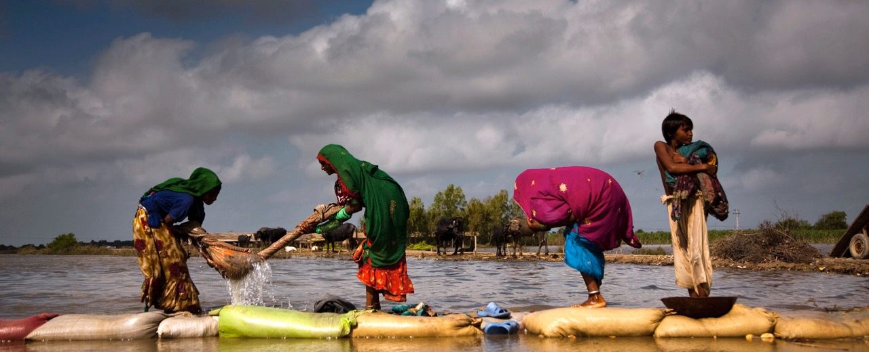






Exploring Faith and Spirituality in Response to GBV Survivors: Implications for Humanitarian Practice
GBV AoR Community of Practice
SUPPORTING HUMANITARIAN ACTORS TO PREVENT AND RESPOND TO GENDER BASED VIOLENCE IN EMERGENCIES

Slide 2

Overview and Agenda
Welcome and Introduction – Sarah Martin, GBV AoR Community of Practice
Plenary Speakers:
Sandra Iman Pertek, University of Birmingham and GBV consultant
  Dr Romina Istratii, SOAS University of London and PI of project dldl/ድልድል
  Dr. Elisabet le Roux, Unit for Religion and Development Research, Stellenbosch University

Slide 3
Small Discussion Groups
Group 1:
Sandra Iman Pertek
Group 2: Africa
Ms. Juliet Eneh, Methodist Church and Doctoral Researcher in Lagos, Nigeria
Group 3: Middle East (with Arabic)
Mr. Anthony Keedi, Abaad, Lebanon
Group 4: Middle East (no Arabic)
Ms. Sana Basim, Mission East, Iraq
Group 5: Africa (French Interpretation)
Ms. Francesca Quirke, Tearfund, UK

Slide 4
Group Rules
Be Kind, Respectful, and Courteous
Add comments to the Jamboard anonymously if you wish
Participate and share
Chatham House Rules: You can speak about what was said, but you cannot explicitly or implicitly say where the source of that information came from.
Survivor-centered principles – promote confidentiality, safety, non-discrimination!

Slide 5
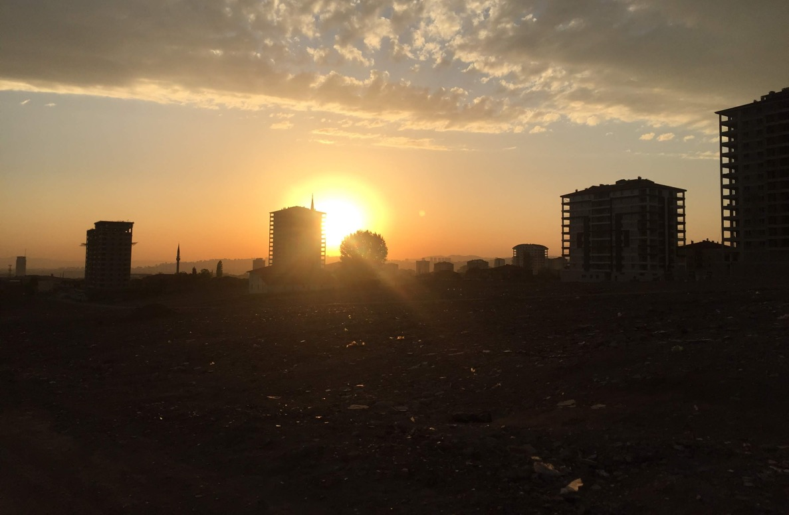

The Faith In(ex)clusion Spectrum in GBV Response
Sandra Iman Pertek sandra.m.pertek@pgr.bham.ac.uk @sandrapertek

Slide 6

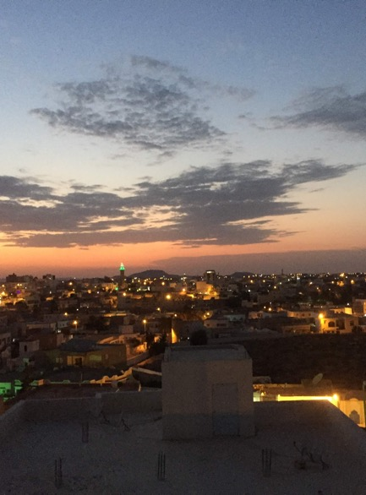
Research overview
Research overview:
  Service providers Q: In what ways do GBV service providers account for religion of survivors?
  Survivors Q: How does religion influence forced migrant women’s experiences of violence?
Sample:
  16 key informant interviews (5 in Turkey, 5 in Tunisia, 6 International)
  25 practitioners completed online surveys
  (17 international, 5 national, 1 regional, 2 from local offices including from Syria, Turkey, Pakistan, Ivory Coast, Australia, Bangladesh, Jordan, UK, Afghanistan, MENA, Kenya, Libya, Iraq, Sudan and Yemen)
  21 Syrian and two Iraqi forced migrant women in Turkey, five Nigerians, three Congolese, two Ivorians, and one each from Eritrea, Ghana, Guinea, Sierra Leone and Sudan in Tunisia
Notes:
Checklists and guidelines don’t look at religion – is part of culture and social norms – some most crucial for effective GBV mitigation. Religion – doesn’t do anything on its own – what survivors think? And how do service providers approach it?
Part of intersecting identities

Slide 7
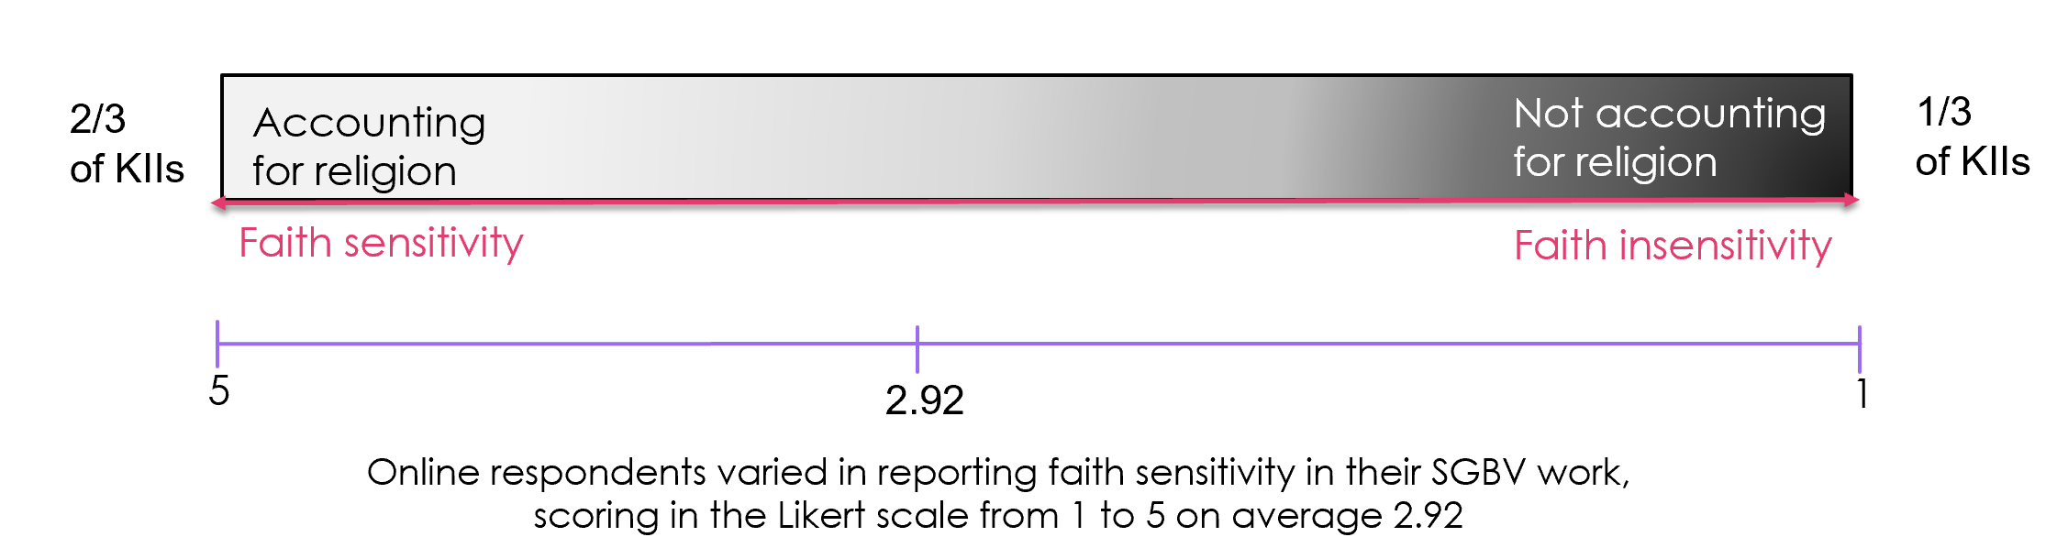
Point 1: The Spectrum of Faith In(ex)clusion
Key factors
Context
Capacities
Attitudes
Cultural relevance
Organisational policies
Personal beliefs
Conflict sensitivities
Humanitarian infrastructure

Slide 8

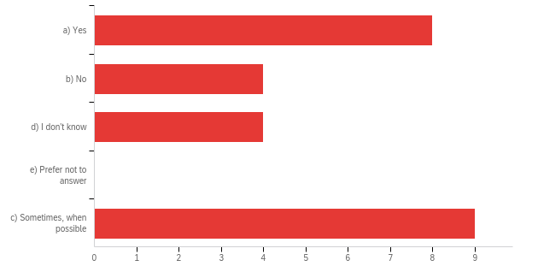
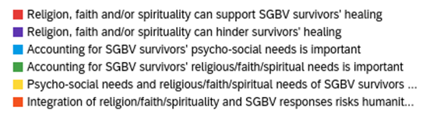
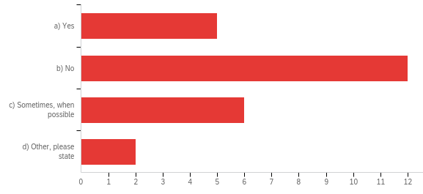
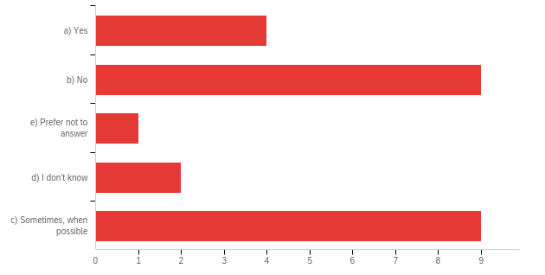
On scale from 1 (very little) to 5 (very much) to what extent do you agree with the following statements
Do you consider your GBV work (with survivors, prevention, service provision, protection etc.) to be faith sensitive?
Survey highlights
A bit
Much
Very much
Is the religious/faith identity of GBV survivors accounted for in your work?
Do you use religious, faith or spiritual resources to support GBV survivors’ resilience, healing, coping?

Slide 9
Point 1: The Spectrum of Faith In(ex)clusion
“…a lot of resistance to talking about religion…in the case management trainings...one of the trainers…said, ‘so if anyone brings up religion…you can't engage with that…change the subject…” GBV Specialist, INGO, Int.
Reactive
pragmatic
approach
Reactive
instrumental approach
Active
approach
Accounting for religion
Not accounting for religion
“…if my client says she reads Qur’an and it helps her, I support it…in every session, I ask ‘do you read? how was it? do you feel better? how did it help you?’” Psychologist, INGO, Turkey
Split approach
Inactive approach
Figure: The Spectrum of Faith In(ex)clusion in GBV response (Pertek)

Slide 10
TYPE OF APPROACH | ACCOUNTING FOR RELIGION | FAITH SENSITIVITY | VIEW ON RELIGION | PRACTICES (KEY THEMES)
Inactive | Not/barely accounting for religion | Faith insensitive | Limited awareness of using religion for coping. Religion seen as a source of oppression. | Ignored/avoided survivors’ religious beliefs concerning GBV; Overlooked negative religious coping; Not engaged with faith leaders; Unrecognised survivors’ religious needs, didn’t provide religious accessories; Concerned about working with FBOs.
Split | Personally accounting for religion but organisationally | Faith sensitive/ insensitive | Mixed of inactive and re/active views on religion. | Practitioners voluntary supported migrants with faith narratives; Organisations not recognising nor responding to migrant survivors’ faith needs; Organisations adopting a blanket approach in efforts to ensure inclusivity.
Reactive (instrumen-talist & pragmatic) | Accounting for religion to a certain extent | Faith aware | Aware of the positives and negatives of religious coping. Religion seen as a multi-edged sword, used to justify and counter GBV; religious ideas may deter from help-seeking. | Religion discussed in therapies when raised by survivors; Provided facilities for meeting survivors’ needs; Trained faith leaders and engaged in local advocacy to address GBV in local communities; Involved faith leaders in the referrals of cases; Developed guidelines on working with religious leaders; Conducted resource mapping and actors mapping; Stakeholder, cultural and demographic analysis; Included faith dimension in MHPSS activities.
Active | Accounting for religion | Faith sensitive | Actively involved faith-based resources to prevent GBV. Tapping into the transformational potential of beliefs & social norms change
Table 1: Typology of approaching religion in GBV practice (Pertek)

Slide 11
Point 2: Religion & GBV Experience
Forced Migrant Women’s Voices:
Resilience:
– Religion, faith and spirituality are resilience factors and coping resources
- Religious coping mechanisms: cognitive, behavioural and spiritual coping strategies
- Social context & loss of religious resources impact on survivors’ coping & healing
Intersecting vulnerability:
– Intersecting vulnerabilities: religious persecution, racialised religious discrimination
- The gender-culture-religion nexus: social norms and patriarchal cultural influences, internalised factors
“Religion is everything in my life, it’s what’s keeping me going…” Amina, Syria, Refugee
“When you’re walking in the desert you have to have faith…” Grace, Ghana, Asylum seeker
“…It is God who has allowed me to escape from this violence” Gloria, DRC, Irregular migrant
“…he says that God made it obligatory for women to obey their husbands…”
Roqaya, 30s, Syria, Refugee
Resilience & Religious Coping
Socio-ecology
Intersecting vulnerability

Slide 12
Reflecting on Point 1 & 2
Key take away: a disconnect between how service providers approach religion in crisis and how women experience religion in GBV experience. A limited recognition of how religion shapes women’s experience
There is a need to account for roles of religion in GBV experience to build upon women’s resilience, spiritual capital (religious resources) and capacities to cope with GBV experience, and also to recognise intersecting vulnerabilities

Slide 13

Implications for humanitarian practice
As per 16 GBV Standards:
Support survivors’ healing through their known ways of coping, consider religion/faith/spirituality in a coping mechanism.
Adapt interventions to survivors’ spiritual and religious needs (but not assume their needs and affiliations, ask).
Mitigate potentially negative effects & vulnerabilities related to intersecting identities, including religious identity.
MHPSS:
Ask, recognise, support, refer to useful faith resources/actors
Notes:
Contrast the spectrum VS. survivor of faith XP
Worldview, thinking framework
Religion is not all good or all bad, there are ways to work with religion in SGBV reduction and MHPSS for survivors

Slide 14
Recommendations
1. Integrate an intersectional and ecological approach to GBV:
Consider an intersectional analysis of GBV, including religious factors
2. In survivor-centred approach recognise religious/spiritual/non-faith coping strategies to strengthen coping mechanisms:
Consider diverse resilience expressions, healing patterns, consider to facilitate access to religious and cultural accessories
Recognise religious needs as part of wellbeing in faith communities and mitigate negative effects of unmet spiritual needs/tensions
Recognise the link between religious coping and menta health (with positive and negative impacts)
3. Invest in capacity building to engage with religious factors:
Support development of faith literacy as a cultural competency
Support safe spaces for women to discuss their faith and empower each other ‘from within’ joint resources
GBV guidelines might consider religious factors to mobilise faith resources and faith actors
4. Recognise religion in MHPSS and resilience frameworks and consider positive and negative functions of religion in coping behaviours.
Recognise intersecting forms of violence in the continuum of violence. Mitigate risks related to religious identity, beliefs and practices
Consider to sensitively disaggregate data by religion if used to inform interventions

Slide 15
Thank you & further materials
Rutledge, K., Pertek, S., Abo-Hilal, M. and Fitzgibbon, A. (2021) Faith and mental health and psycho-social support (MHPSS) among displaced Muslim women. Forced Migration Review 66. https://www.fmreview.org/issue66/rutledge-pertek-abohilal-fitzgibbon
Webinar series: Supporting Survivors of Faith by Safe Havens for different faith traditions: https://www.interfaithpartners.org/webinars
Spiritual Power and Control Wheel by Safe Havens: www.interfaithpartners.org
Sandra Iman Pertek
sandra.m.pertek@pgr.bham.ac.uk @sandrapertek

Slide 16
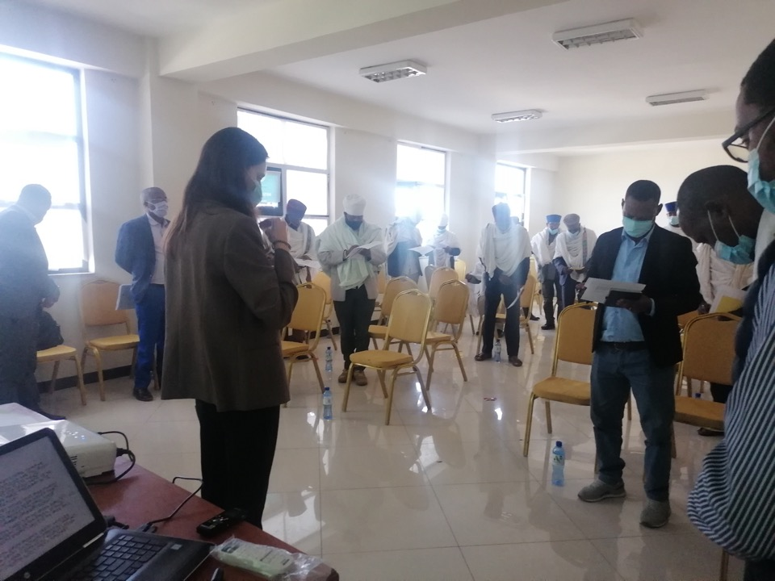
Understanding the colonial legacies that underpin engagements with religious parameters in humanitarian response and public health
Dr Romina Istratii
SOAS University of London
PI of Project dldl/ድልድል: “Bridging religious studies, gender & development and public health to address domestic violence: A novel approach for Ethiopia, Eritrea and the UK”

Slide 17
The system of knowledge production
Epistemological dominance of western Europe/North America dictating theory and paradigms and what matters as valid knowledge
01
Material inequalities with most funding being located in the so-called global north dictating its own standards of practice & performance (theory of change, Results-based, value for money, impact, capacity building, etc.)
02
Ideological and political asymmetries with so-called global (a.k.a Northern) agendas dominating the fields of development, public health and humanitarian responses (Agenda 2030, SDGs, etc.)
03

Slide 18
What do we mean by epistemological dominance?
Individuals are always ‘epistemologically situated’, which means that their worldview influences their conceptual, theoretical and analytical framework.
Historically, the Western European colonisers projected their worldviews, interests and understandings of humanity onto the ‘other.’ Ngũgĩ wa Thiong'o referring to colonialism wrote:
    …its most important area of domination was the mental universe of the colonized, the control, through culture, of how people perceived themselves and their relationship to the world. (1986, 16).
In contemporary times, lack of recognition about the epistemological situatedness of historical paradigms and limited self-reflexivity about personal positionality in research, knowledge production and development practice means that western assumptions continue to be transposed cross-culturally and to dictate standards and paradigms.

Slide 19
Colonial legacies in how ‘religion’ has been theorised cross-culturally
The mainstream epistemology of ‘religion’ is the product of western societies’ distinct experience with western Christianity, capitalism and secularism. Historically, different thinkers engaged with ‘religion’ in ways that resonated with the stage of western development, such as analysing ‘religion’ as a natural phenomenon, as a transcendental thing-in-itself (sui generis), or as a symbolic system, with non-western religions being analysed in reference to what was perceived to be a superior western Christianity.
Although in recent years this epistemology of religion has diversified, motivating the infamous ‘world religions’ paradigm and more hermeneutical approaches, deeply western entrenched assumptions about what ‘religion’ is have yet to be overcome. For example, tis remains deeply grounded in humanistic notions of religious conscience, assuming a division between conscience (as belief) and its embodiment (as practice), as well as attaches an attribute o individuality to conscience, which need not be the case in societies whose faith Is intertwined with collective values, histories and identities as in this one.
Employing a west-centric gender theory and a feminist ‘hermeneutics of suspicion’, prominent feminist scholars in gender and theology/religion(s) studies have displayed essentialising tendencies that present all ‘theology’ (especially Christian traditions) as ‘patriarchal’ or ‘sexist’, showing limited reflexivity of historical and exegetical differences across traditions and geographies.

Slide 20
Colonial legacies in how ‘gender’ has been theorised cross-culturally
Gender equality is a political objective – whose gender equality, for what purposes, and where are the boundaries with research and practice internationally?
The issue of western Euro-centrism in the definition of gender and conceptualisation of gender relations, by predicating gender on biology and visual indicators (Oyèrónkẹ́ Oyěwùmí, 1997; Ifi Amadiume 1987, Arnfred 2011)
Mainstream gender theory underpinned by the assumption of hierarchical gender – ignores plurality in gender relations and status of women across the world (Nkiru Uwechia Nzengwu, 2006)
Definitions of gender, gender equality and empowerment can be incommensurable with local belief and knowledge systems, especially those embedded in religious metaphysics (Istratii, 2017)
Intersectionality does not eschew epistemological issues – identity vectors usually defined as inequalities “essentialising the oppressed subject” (Cramer 2015), while non-discursive or spiritual planes are often neglected (Istratii, 2017)
Interventions that pursue gender equality in ways not attuned to local belief and value systems can appear neo-colonial, causing backlash (Oluwafunmilayo Para-Mallam et al., 2011; Mannell, 2012)

Slide 21
Colonial legacies in how GBV/domestic violence has been theorised cross-culturally
GBV/Domestic violence in low- and middle-income countries (LMICs) has been frequently under-theorised, or theorised on the basis of a single aetiology or in relation to western industrialised societies’ experiences with gender inequality. This reflects the ways in which feminist movements evolved in North America and Western Europe, influencing international discourses and practices.
The systematic representation of these societies as gender unequal, and the stubborn emphasis on socio-cultural explanations, combined with the notable neglect of psychological and trauma-related aetiologies, tends to reinforce postcolonial and other critical arguments based on those historical beliefs about less ‘civilised’ or inherently violent non-western cultures that continue to underpin some Anglo-American thinking (Narayan, 1977; Volpp, 2005).

Slide 22
Overall outcomes in gender and development and public health practice
Very little research has explored alleviation strategies within religious worldviews and context-specific socio-cultural systems, trying to leverage o religio-cultural resources.
Over the past two decades, the international development sector has moved to integrate the contribution of faith leaders in the furthering of development agendas, in acknowledgment of their influential role in communities. However, these approaches have never overcome western assumptions about ‘religion’ as dictated by these societies’ experience with western forms of Christianity and Enlightenment struggles (Herstad, 2009; Rakodi, 2012).
Much discourse has revolved around institutionalised ‘religion’ and religious leaders, and many faith-inclusive approaches have failed to consider not only the holistic and multi-dimensional ways in which religious traditions and belief systems have been experienced in many tradition-oriented societies, but also their complex intersections with the experience of IPV, and victim and perpetrator attitudes.
More programmes in public health engage with religious stakeholders (e.g. in addressing HIV/AIDS, harmful cultural practices that affect women and girls, etc.), but the sector has not eschewed conceptualisations of ‘religion’ and ‘faith’ that demarcate religious beliefs and conscience in humanistic ways and fail to embed them in wider normative frameworks and societal structures.

Slide 23
The humanitarian sector’s relationship to religious beliefs and traditions
Recent rapid scoping literature review to identify the state of evidence on the relationship between political violence and domestic violence and to explore the long-term consequences of political violence, such as in forced migration.
This evidenced that religious parameters have received minimal attention in the humanitarian scholarship, and should be better integrated when appraising alleviation strategies in conflict , post-conflict contexts and displaced populations. The resourcefulness of religious personnel not generally considered or assessed, although reports exist that religious beliefs and spiritual activity can serve coping mechanisms.
That faith serves as a coping mechanism has been reported also widely in the literature that examines domestic violence in religious communities. In such contexts, female victims may resort to religious beliefs to condemn the abuse and through their ordeals may acquire a more justice-oriented understanding of their faith, helping them to address the harmful situation (Shaikh, 2007; Johnson, 2015; Nason-Clark et al., 2018).
Previous research in Ethiopia that analysed conjugal abuse in the countryside and the city of Aksum through the religio-cultural framework found that faith helped women to face and overcome difficult situations and painful marital experiences (e.g. separation, divorce or spousal unfaithfulness) and did not generally serve as a source for justifying intimate partner abuse, which the faith clearly taught against (Istratii, 2020).
However, culture-specific folklore practices and understandings that may be conducive to gender inequalities or related abuses are often framed in religious terms in contexts where religious traditions prevail and shape everyday life. Thus, it is important to recognise that perpetrators might use religious language to justify their actions or ease their conscience. In other societies, communities may follow traditional beliefs around spirit activity that can amplify the consequences of war violence for victims/survivors or ex-combatants (e.g. Saile et al., 2013).

Slide 24
Thank you!
For questions or comments, please reach me at ri5@soas.ac.uk

Slide 25

Looking to the local: centring local religious institutions, actors and expression in GBV response in humanitarian settings
Dr Elisabet le RouX
Unit for Religion and Development Research, Stellenbosch University
3 June 2021

Slide 26









Slide 27
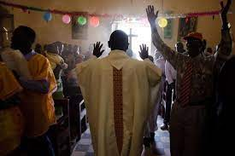
Who are we recognising as religious actors?

Slide 28
(My team) pray, we work with the child, we work with the child’s being. And that lets us ‘infiltrate’, for lack of a better word, their homes. We get to know their mommies and daddies… (W)e say to the mommy that ‘x’ boy or ‘x’ girl was sad. Something’s wrong with the child, right? And maybe the mother trusts us because we’re teachers… and so she tells us, ‘look, this is happening to me, please pray for this, I know that the boy has seen this’. (Female faith leader, Colombia, in Le Roux & Cadavid Valencia, 2020)

Slide 29
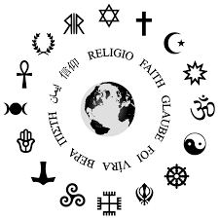
What are we recognising as religious?

Slide 30
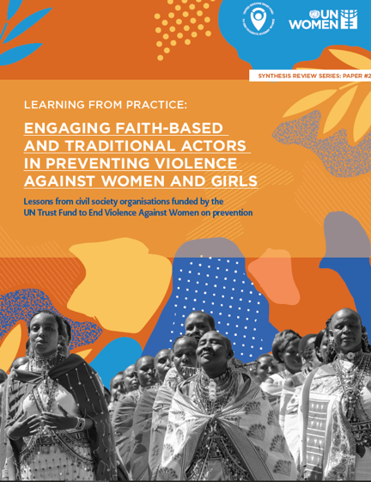

Slide 31
We have strengthened our psychospiritual strategy because we are integrating indigenous and black rituals, with women we have learned new ways that they knew from their ancestors (Coordinator of the psychospiritual strategy, Fundación Mundubat)
It has been very important for me and for black women to know about our stories of resistance, of our marooned age, it is necessary to know of our ancestors and their resistance (Afro-descendant woman taking part in Fundación Mundubatprogramming)

Slide 32

What are we expecting of religious actors?

Slide 33
You search for God, for what the Spirit puts into your mind, it reveals things to you; the Holy Spirit revealed to me that some people… that I know they are talking to me, they are lying to me. You understand that, it comes from God, from the Spirit. Maybe you don’t have that academic knowledge, training in those areas, but you understand what’s happening with the spirit. (Male faith leader, Colombia, in Le Roux & Cadavid Valencia, 2020)
For me the Word of God properly used in their hearts leads to people being healed, and helps dignify people so they can understand it wasn’t their fault. God brings hope that things won’t end there, that it will work for good, that everything will work for good. And the Word of God brings hope and healing to their lives. (Female faith leader, Colombia, in Le Roux & Cadavid Valencia, 2020)

Slide 34
Because this is an important issue: Which is truly our realm as ministers? Right? Do we up and send everyone off to prison? Or do we carry out restoration processes where God can truly change people’s heart? In the eyes of some organisations, what I’m saying here may sound crazy. ‘But he’s a rapist!!’ ‘How can you say that?’ But then, what is the answer? If we sent them all to prison we’d have I don’t know how many men locked up because at one time in their life they did something. Or maybe some women. But is that what’s really going to change them? It’s complicated. I mean, in these cases I really don’t know what to do. (Female faith leader, Colombia, in Le Roux & Cadavid Valencia, 2020)

Slide 35
Thank you!
Dr Elisabet le Roux
Unit for Religion and Development Research, Stellenbosch University
eleroux@sun.ac.za

Slide 36
Small Discussion Groups
Group 1: Sandra Iman Pertek
Group 2: Africa Experience
Ms. Juliet Eneh, Methodist Church and Doctoral Researcher in Lagos, Nigeria
Group 3: Middle East (with Arabic)
Mr. Anthony Keedi, Abaad, Lebanon
Group 4: Middle East (no Arabic)
Ms. Sana Basim, Mission East, Iraq
Group 5: DRC and global (with French)
Ms. Francesca Quirke, Tearfund, UK

Slide 37

Please Take our Survey!
https://www.surveymonkey.com/r/8GS9V3Y

Slide 38






Resources provided by the
GBV AoR
Community of Practice
https://gbvaor.net/support
Help Desk
https://gbvaor.net/support
Monthly Update Newsletter
Sign up through our website
Twitter
@GBVAoR1
Facebook
@GBVAoR1
Website
https://gbvaor.net
YouTube.com
Search <GBVAoR>
Videos of past events
Sound Cloud
Podcasts https://soundcloud.com/user-188404020 -

