Slide 1
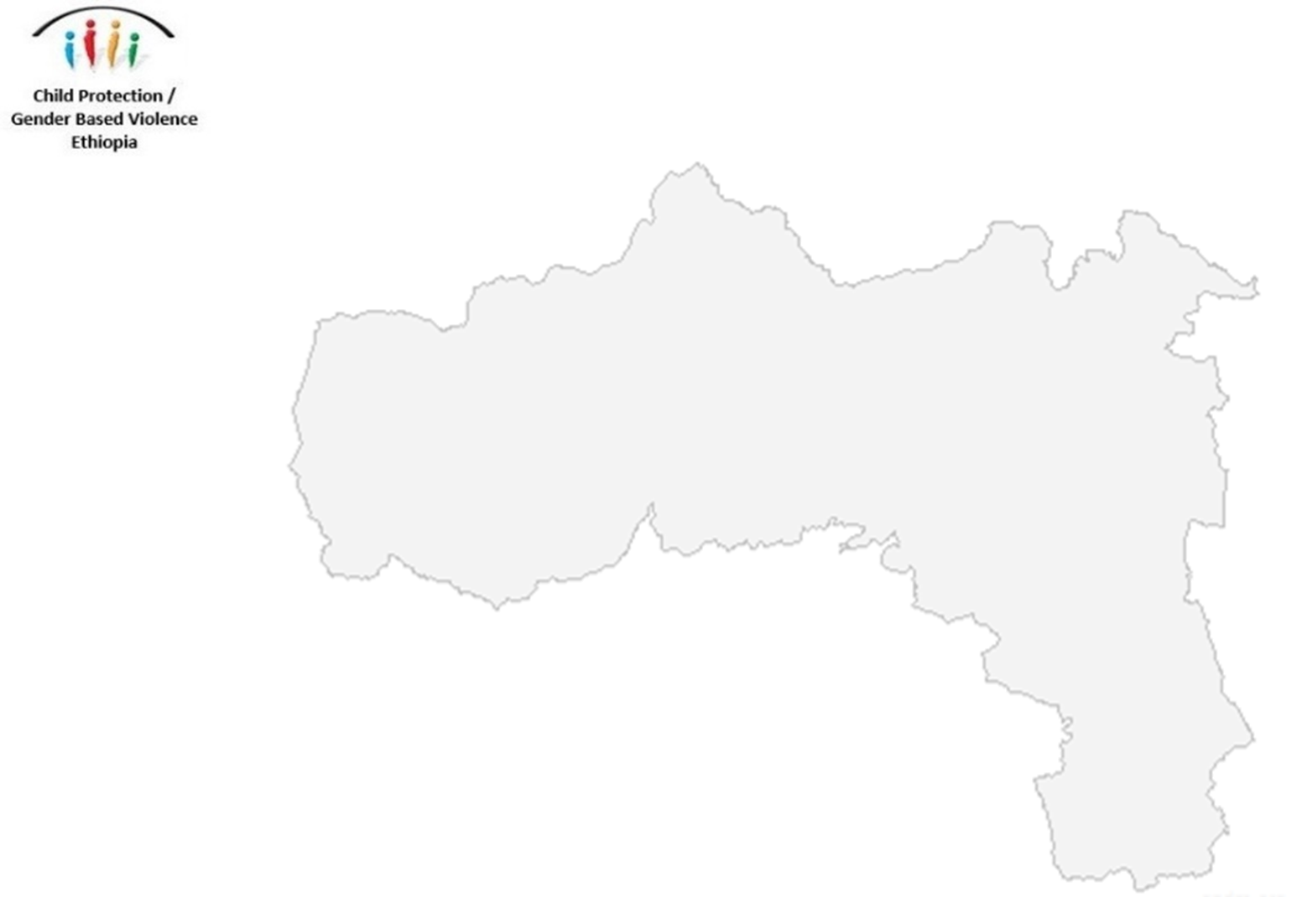

Child Protection and Gender-Based Violence in Tigray Briefing
23 April 2021. 2.00pm EAT

Slide 2
Agenda
Child Protection and GBV Situational Analysis
Humanitarian Response Plan and progress
1
Welcome
3
2
6
4
5
Q&A
Response Plans
Closing Remarks
Notes:
Welcome.
Child Protection and GBV Situational Analysis. Imagine one Day (Tigray Program Manager) and UNICEF (Markus Larsson, Emergency Specialist)
Humanitarian Response Plan and progress – Dientje van Dongen (GBV AoR co-coordinator) and Eric Wyss (CP AoR co-coordinator)
CP/GBV AoR Response Plans (Getashu, Bureau of Labor and Social Affairs) and Dientje van Dongen (GBV AoR co-coordinator)
Q&A
Closing Remarks. Jessica Gorham, UNFPA Regional Emergency GBV Advisor for East and Southern Africa

Slide 3
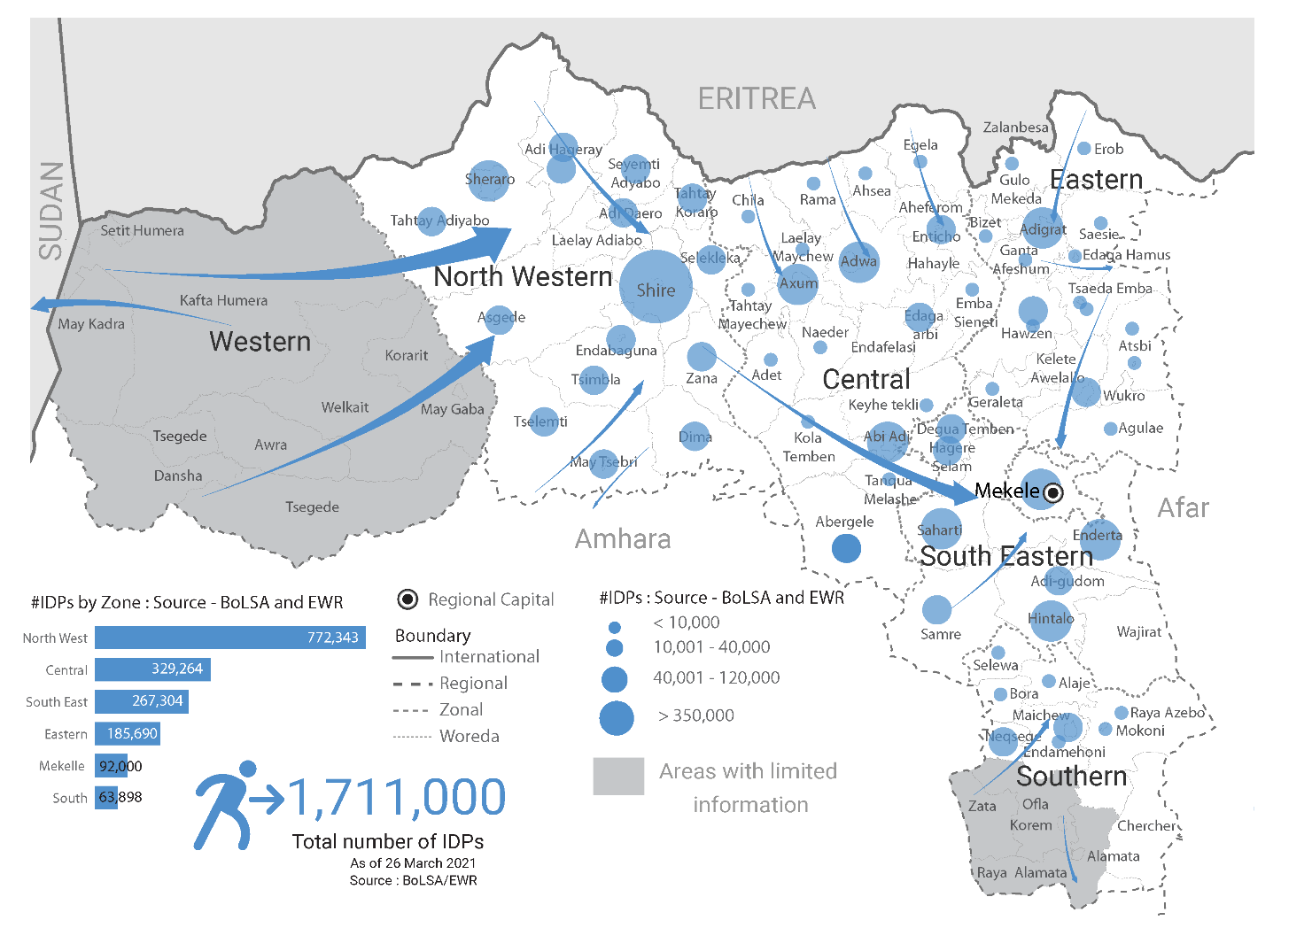
Situational Analysis
2

Slide 4

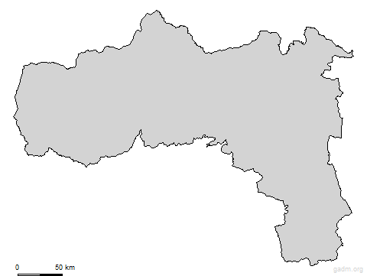
GBV Situational Analysis
Gender-Based Violence
Report of GBV by people fleeing, staying behind, hiding, when accessing water and other basic needs/services. Also when sheltering, women and girls continue to being exposed to risk.
  Including a high number of child and adolescent survivors
Types of violence include sexual violence, rape, attempted rape, intimate partner violence, psychological abuse and psychological violence, survival sex
High risk environment with:
  Presence of armed actors
  IDP hosting sites carry huge GBV risks including in and around latrines and shelters.
  Extreme food shortages leading negative coping mechanism including transaction sex/survival sex
Service environment
Extremely limited
Health, case management, MHPSS used to be centralised
GBV situational analysis provides more detail
Services not accessible / underreporting: distance, stigma
2

Slide 5
Safety audits in Tigray (UNICEF)
In March – April 2021:
9 IDP sites visited in Adigrat, Shire, Axum and Adwa
Observational checklist was used (previously validated in Ethiopia).
FGDs with women and adolescent girls living in the camps to understand security and safety concerns/perceptions.
Key informant interviews with NGOs and government agencies to map activities and services.
2
Notes:
In March – April 2021:
9 IDP sites visited in Adigrat, Shire, Axum and Adwa to conduct multisectoral safety audits to assess site level GBV/protection risks across sectors.
Observational checklist was used (previously validated in Ethiopia).
FGDs with women and adolescent girls living in the camps to understand security and safety concerns/perceptions.
Key informant interviews with NGOs and government agencies to map activities and services.

Slide 6
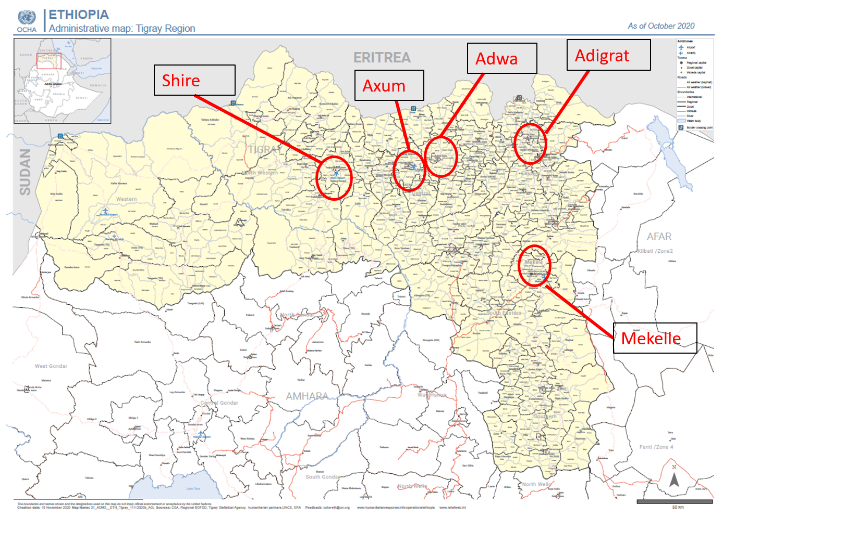
Safety audits in Tigray (UNICEF)
2
Notes:
In March – April 2021:
9 IDP sites visited in Adigrat, Shire, Axum and Adwa to conduct multisectoral safety audits to assess site level GBV/protection risks across sectors.
Observational checklist was used (previously validated in Ethiopia).
FGDs with women and adolescent girls living in the camps to understand security and safety concerns/perceptions.
Key informant interviews with NGOs and government agencies to map activities and services.

Slide 7
Selected findings
Almost all IDP sites visited, lacked proper fence, lights, lockable doors and basic services
Problems with overcrowding
Few sites (1) offered women and girls safe spaces.
Women and girls expressed trauma-based concerns
They also witnessed GBV incidents taking place inside the IDP camps
  ‘culture of silence’
2
Notes:
Almost all IDP sites visited, lacked proper fence, lights, lockable doors and basic services (WASH, early childhood development, health).
Problems with overcrowding: at some sites people slept on the ground, including women and their children.
Few sites (1) offered women and girls safe spaces.
Women and girls expressed concerns about what they had faced during movements and the trauma they now are dealing with. Both women and girls knew of those who wake up screaming in the night and who are afraid of interacting with males as a result of what they have gone through.
They also witnessed about GBV incidents taking place inside the IDP camps but referred to the ‘culture of silence’ or fear of retaliation as main sources to why survivors not seek help. General misbelief of legal and security services provided by authorities as not functioning. Many believed that this too was one of the main reasons why some survivors not seek assistance.

Slide 8
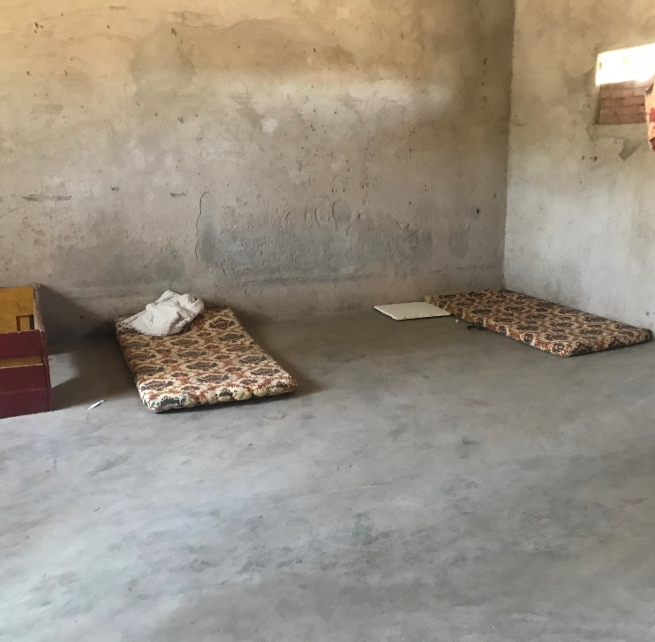
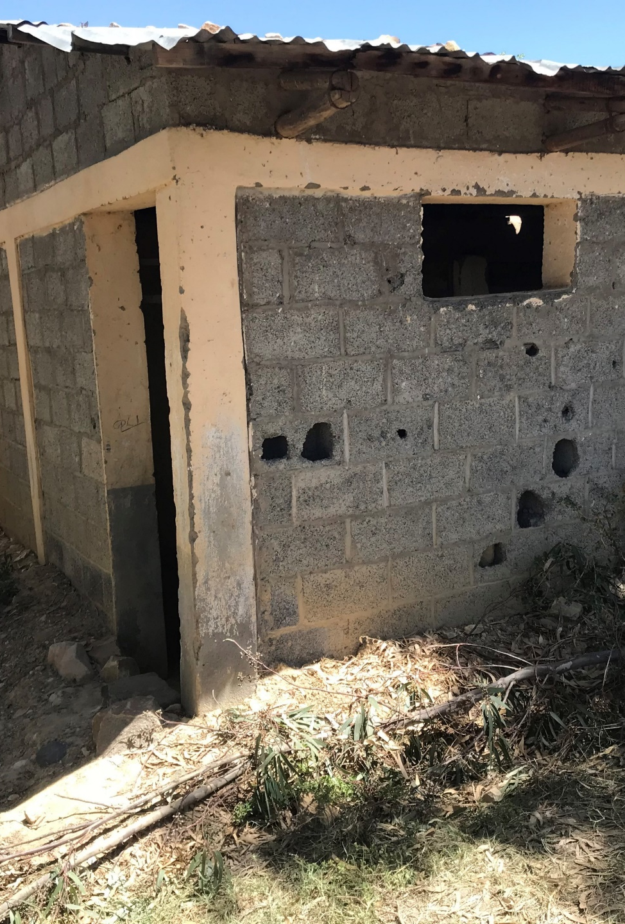
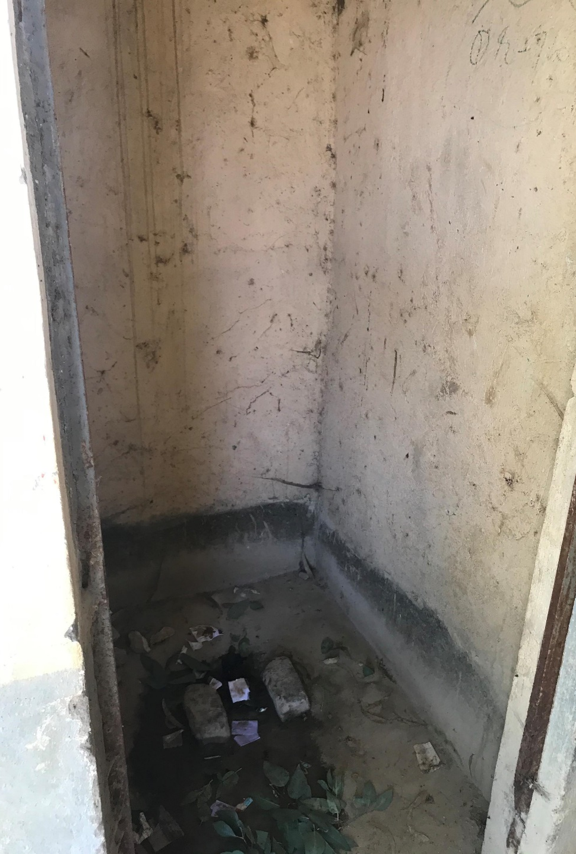
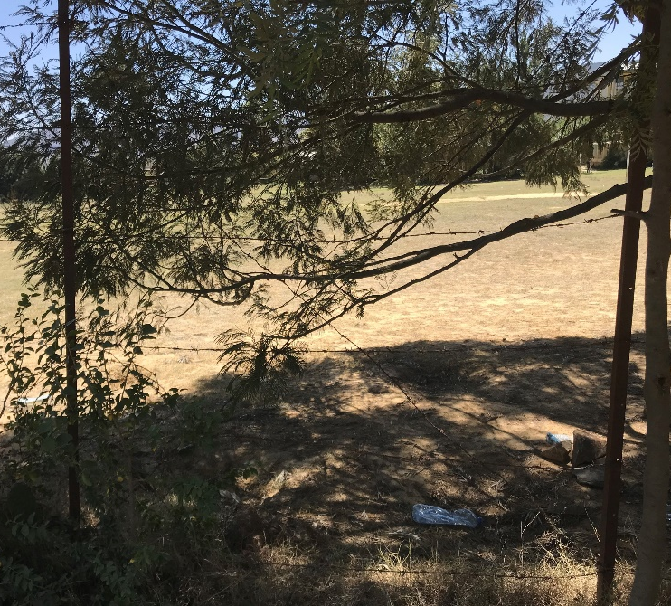

Slide 9
Selected recommendations
2
Update and complement the referral pathways to enable appropriate services to survivors.
Frontline workers need to be briefed on existing referral
Support NGOs/specialized agencies to work with health centers to strengthen their capacity
Need for GBV mainstreaming across all sectoral responses to scale-up:
Notes:
Important to continue working to update and complement the referral pathways to enable appropriate services to survivors. Need to go beyond Mekelle and Shire. CP-GBV AoR plays a main role.
Frontline workers need to be briefed on existing referral pathways to ensure timely referrals but also trained on how to refer a survivor (in the event of disclosure) – GBV Pocket Guide translated into Tigrinya and UNICEF, UNFPA and UNWOMEN will organize trainings for the roll-out.
Support NGOs/specialized agencies to work with health centers to strengthen their capacity, including GBV, to extend services beyond the existing and planned One-Stop-Centers – especially in smaller towns.
Need for GBV mainstreaming across all sectoral responses to scale-up: risk mitigation and response. Sectors should work with GBV specialists throughout the project cycle to make sure that the services/activities address the needs of survivors and adhere to the principle of ‘do no harm’.

Slide 10


REPSPONSE PLAN 2021 - Tigray
$ 32.5
3
People in Need
Analysis of needs across 87 woredas
Based on displacement numbers, ratio to host communities
Based on % of women, girls, boys and men in the communities
Target
Based on globally agreed estimated percentages based on PIN
Includes both IDPs and host communities

Slide 11


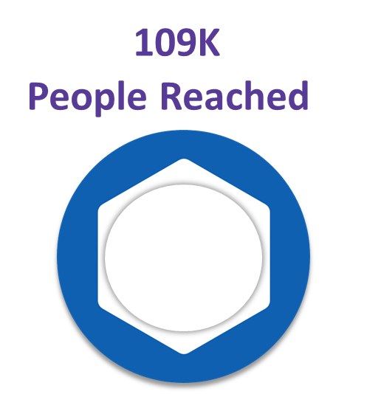
CP and GBV Response to Mid April 2021
Funding request $ 32.5
Funding confirmed $ 6.7
Funding pipeline $ 2.3
Funding gap (request – confirmed) $ 25.5
3

Slide 12
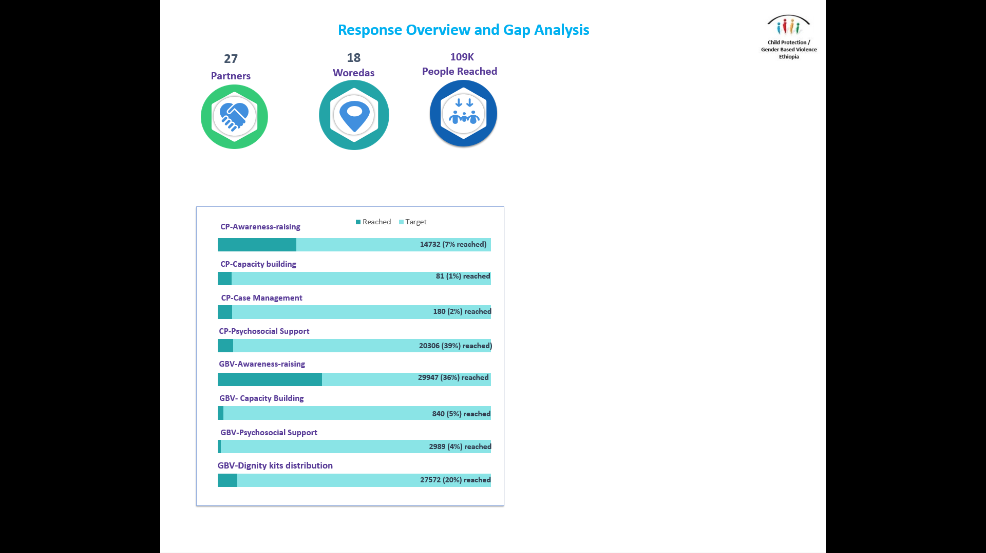
Child Protection response progress
Actions to date mainly around bigger populated towns (Mekelle, Shire and in a lower measure in Axum and Adigrat).
Main activities
  Deployment of 48 social workers to support BolSA and update of referral pathways
  Training of new social service workforce on different issues (CM , referral pathways, PFA)
  Distribution of dignity kits
  Establishment of safe spaces (including distribution of tents for IDP sites)
  PSS level 1 and 2
  Identification of children at risk in Mekelle and Shire sites
Activation of CP/GBV AoR in Shire and Mekelle
3
Progress against CP Core Activities
Notes:
Number of partners reporting work on CP has increased to XXX.
Actions to date mainly around bigger populated towns (Mekelle, Shire and in a lower measure in Axum and Adigrat).
The main ongoing CP activities include:
Distribution of XXX dignity kits to girls
Basic PSS (safe and temporary learning spaces in most of Mekelle and Shire)
Distribution and establishment of spaces (tents) to support CP work and safe spaces in Shire and Mekelle
Deployment of Ssocial workers to support BolSA and update of referral pathways
Training of new workforce on different issues (CM, referral pathways, PFA)
Activation of CP/GBV AoR in Shire and Mekelle since January, with coming establishment of technical working groups on CM, FTR and MHPSS to reinforce coordination in those areas. Information management will be reinforced soon as well.
Identification of children at risk in sites (even if FTR, alternative care and CM are still very limited)
Assessments
CP and GBV integrated into interagency responses
Agency specific assessments in areas locations of work

Slide 13
Child Protection response challenges
Access, size of sudden influx and ongoing environmental risks (e.g. schools closed)
Presence and capacities of CP actors and BolSA, including staffing
Urgent areas to scale up
  FTR and alternative care, including safe information management
  MHPSS (level 1-2 and supply of basic medication and counseling services)
  Identification and safe referrals of children at risk
  Capacity building
  Geographic expansion, including to families living with host communities
To start scaling up
  Case Management (including coordination according to national framework)
  MHPSS level 3-4 (with health)
  CP Mainstreaming (CCCM, education, AAP, health, access to basic goods)
  Protection and presence in current areas of displacement (Western Zone)
3
Notes:
Number of partners reporting work on CP has increased to XXX.
Actions to date mainly around bigger populated towns (Mekelle, Shire and in a lower measure in Axum and Adigrat).
The main ongoing CP activities include:
Distribution of XXX dignity kits to girls
Basic PSS (safe and temporary learning spaces in most of Mekelle and Shire)
Distribution and establishment of spaces (tents) to support CP work and safe spaces in Shire and Mekelle
Deployment of Ssocial workers to support BolSA and update of referral pathways
Training of new workforce on different issues (CM, referral pathways, PFA)
Activation of CP/GBV AoR in Shire and Mekelle since January, with coming establishment of technical working groups on CM, FTR and MHPSS to reinforce coordination in those areas. Information management will be reinforced soon as well.
Identification of children at risk in sites (even if FTR, alternative care and CM are still very limited)
Assessments
CP and GBV integrated into interagency responses
Agency specific assessments in areas locations of work

Slide 14
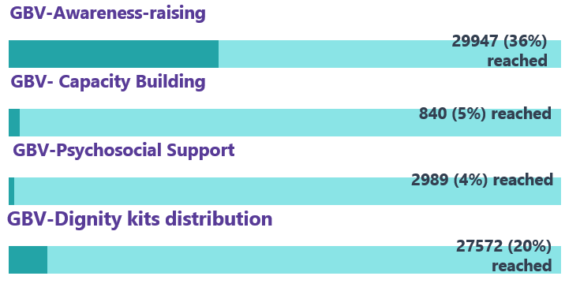
Panel discussion
GBV Response Progress
Comprehensive services through One Stop Centers to be scaled up
Safe shelter (women’s rehabilitation centre) expansion
Women safe spaces and structured community conversation
Reach to non-urban areas mainly through distributions
Limited case management capacity, capacity building necessary on basic GBV guiding principles, and specialisted services
Prevention and mitigation
Advocacy and monitoring
3

Slide 15
Panel discussion
GBV Response Challenges
Safety and security
  Access
  Safety and security of staff
Basic services for operating
Government service structure collapse
Financial
Technical
Coordination and information management
3

Slide 16
CP and GBV AoR Response Plan
Operational plan developed with regional government, UN, and NGO partners in February 2021.
Includes focus on 7 key areas
  Coordination
  Child protection case management
  Comprehensive and multi-sector response services for GBV survivors
  Alternative care arrangements for unaccompanied, orphaned and separated children
  Mental health and psychosocial support for women & children
  Community outreach and awareness raising
  Complaint and feedback mechanism, incl SEA reporting
4

Slide 17
Health and Protection Cluster Joint Response Plan to Address GBV
4

Slide 18
5
Questions & Answers

Slide 19
Closing Remarks and Next Steps
Thank you
6

